Slide 1
Open RAN and Low GloSea6
Dian Hanifudin Subhi

Slide 2
Outline
Weekly report
Summary of this week’s work
Your work
Conclusion
Your opinion/thought
Action item

Slide 3
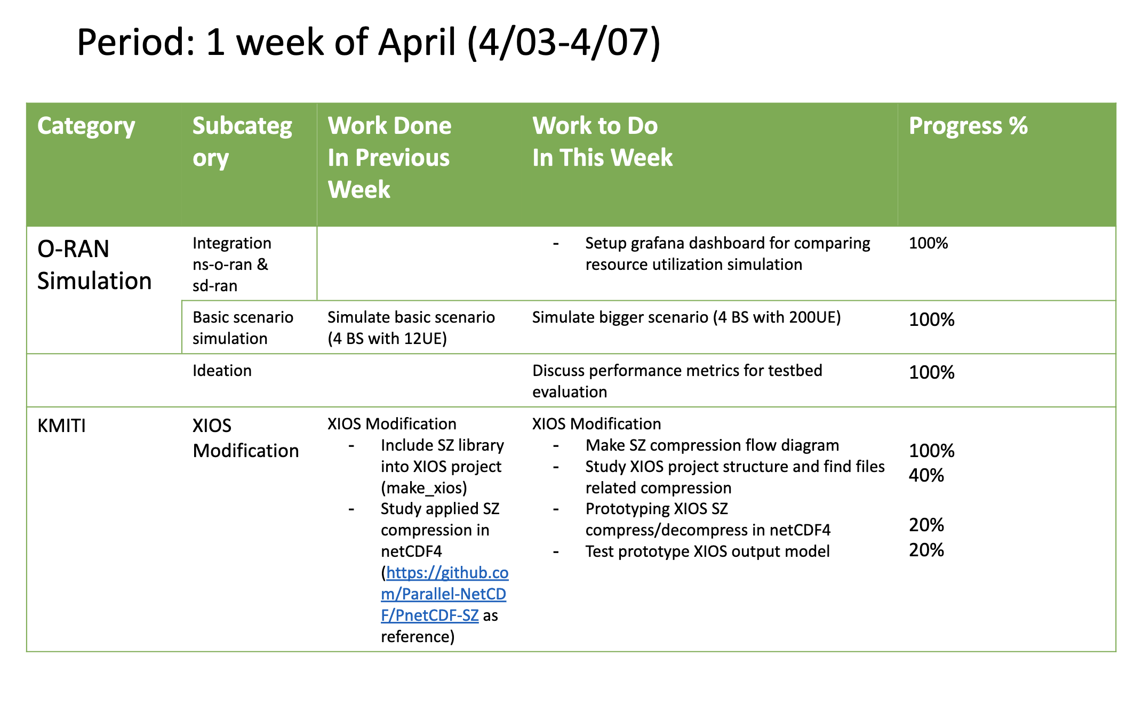
Weekly report

Slide 4
Summary of work this week
Running simulation and gathering metrics performance
Study about XIOS modification related to SZ compression

Slide 5
Question to be Answered
How is the progress of ns3 integration with SD-RAN?
What modification is needed to apply SZ compression?

Slide 6
Setup Grafana Dashboard
Gathering resource utilization via onos-exporter
Resource utilization for ransim pod and ns-o-ran pod
helm -n riab install onos-exporter sdran/onos-exporter --set import.fluent-bit.enabled=true --set import.prometheus-stack.enabled=true

Slide 7
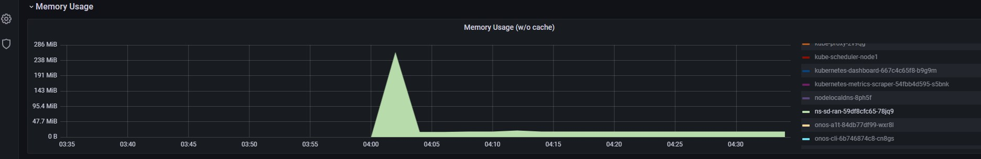
Setup Grafana Dashboard
Visualize metrics in Grafana
kubectl -n riab port-forward svc/onos-exporter-grafana 3000:80

Slide 8
Performance Metrics
Metrics Evaluation
Performance metrics
Scalability
Resource utilization
RAN throughput
Capabilities
Flexibility

Slide 9
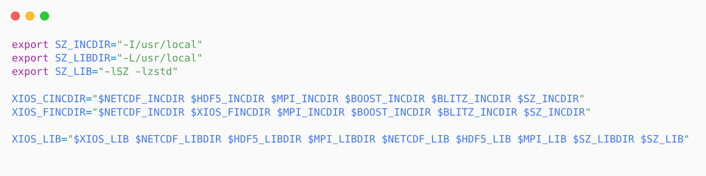
Integrate SZ into XIOS Project
make_xios script modificationn
Modify the make_xios script to include SZ library
Add include and linker related to SZ location path
Add flag for compiler options

Slide 10
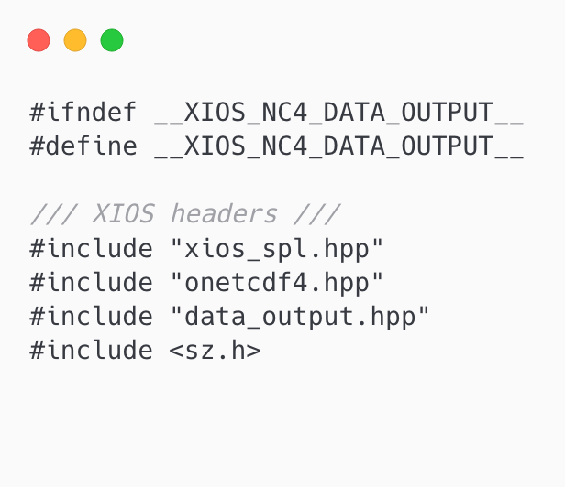
Integrate SZ into XIOS Project
Test SZ Integration into XIOS Project
Add include header for SZ library
Modify the src/io/nc4_data_output.hpp for testing

Slide 11
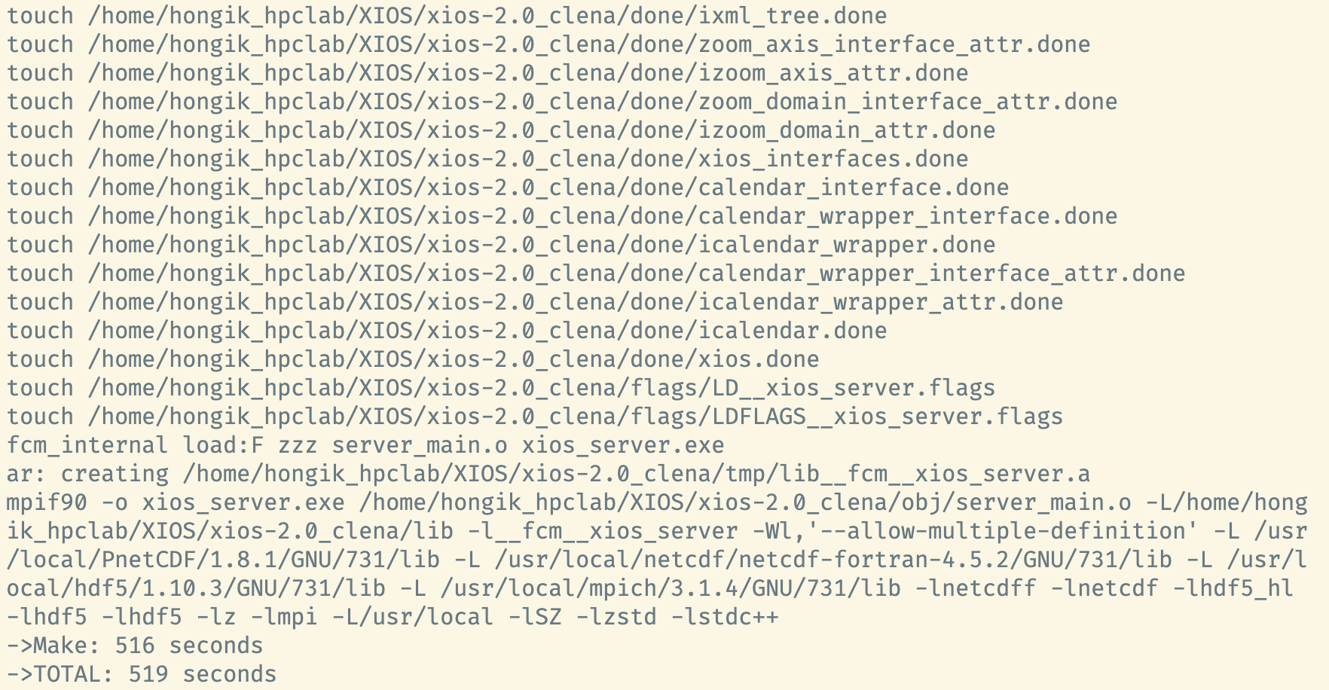
Integrate SZ into XIOS Project
Running Compilation for XIOS Project
Rerun compilation command
./make_xios --full --use_extern_boost true --use_oasis oasis3_mct --prod --arch GCC_local

Slide 12
XIOS Modification
References
PnetCDF-SZ: Integration of SZ compression into PnetCDF (Parallel netCDF)
Only support SZ compression for netcdf classic and cdf5
It’s written on C (XIOS using C++ with C wrapper)
Provides SZ compression logic flow implementation

Slide 13
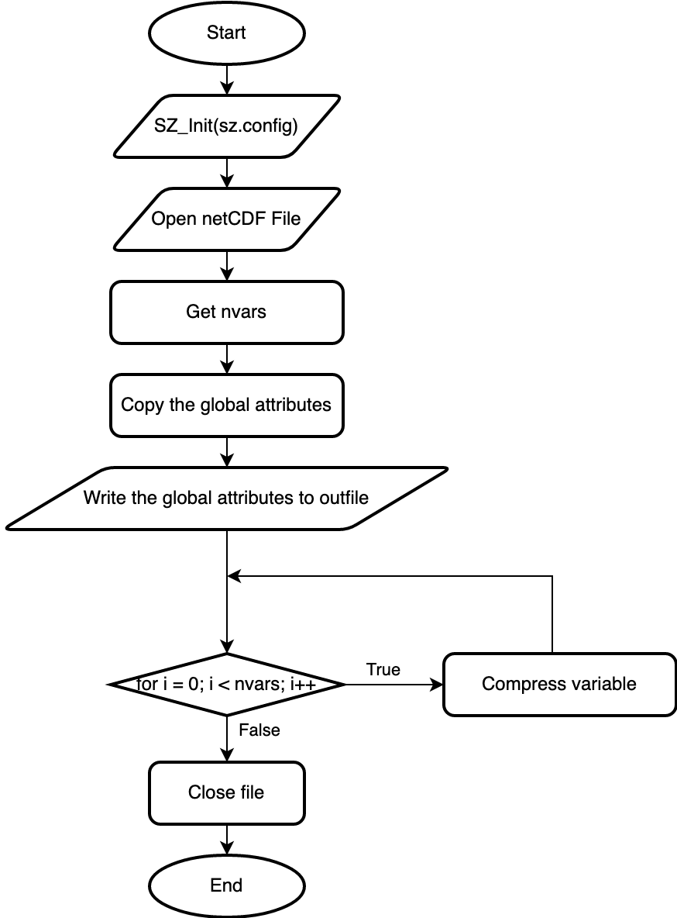
Compression Flow
NetCDF Compression
Performing SZ compression required sz.config
Compression will be performed for each variable

Slide 14
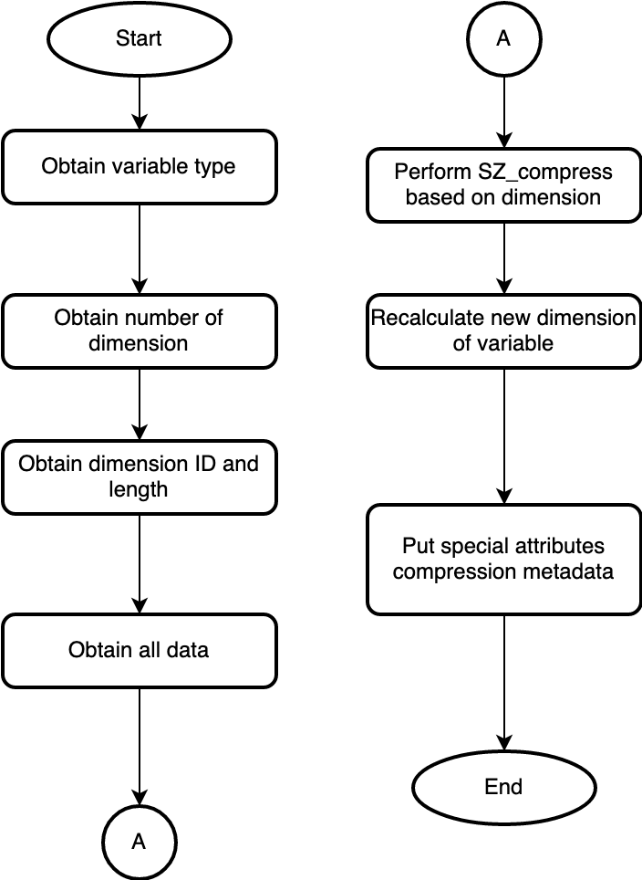
Compression Flow
NetCDF Compression
SZ API
char* SZ_compress(
int dataType,
void* data,
size_t* outSize,
size_t r5,
size_t r4,
size_t r3,
size_t r2,
size_t r1
);

Slide 15
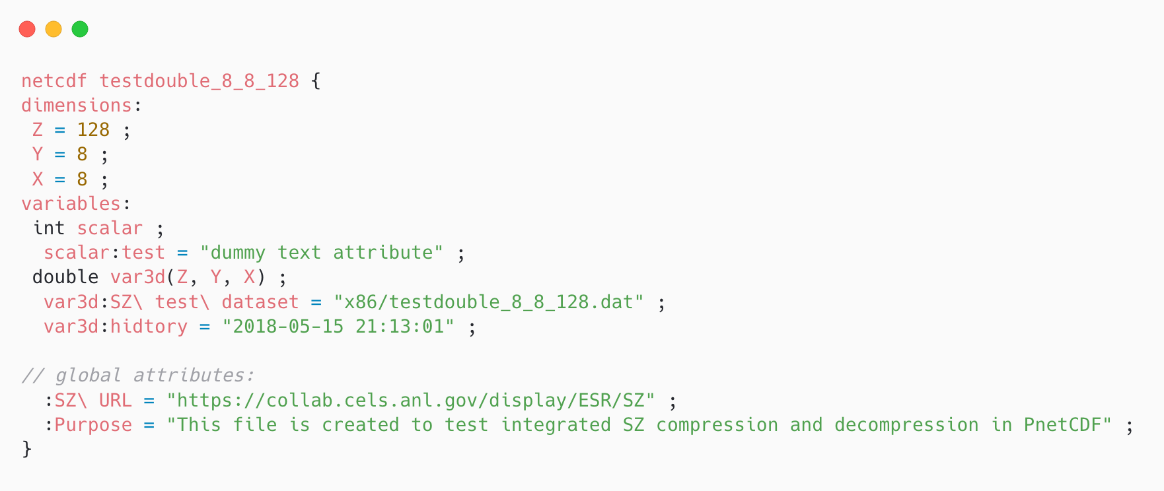
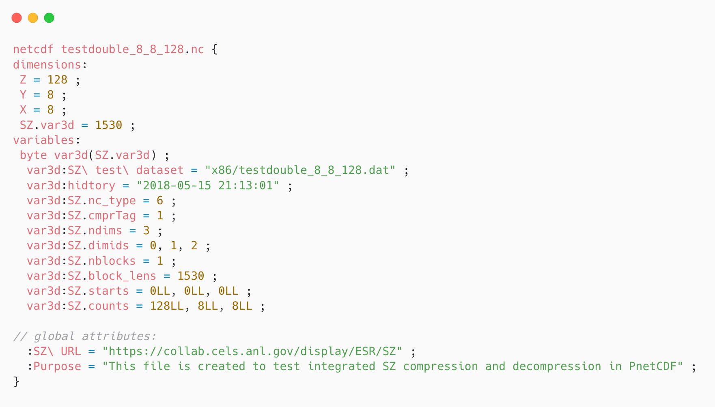
Compression Flow
NetCDF Compression
Original
Compressed

Slide 16
Structure of XIOS Project
Files Related to netCDF Output
io/nc4_data_output.cpp: Class that have write responsibility of variable, attribute and also dimension.
io/onetcdf4.cpp: Responsibility of general output of netCDF capability (open, close, definition and initialize).
io/netCdfInterface.cpp: C++ wrapper of netCDF C API function
node/file.cpp: Have responsibility model file, instantiate netCDF output object.

Slide 17
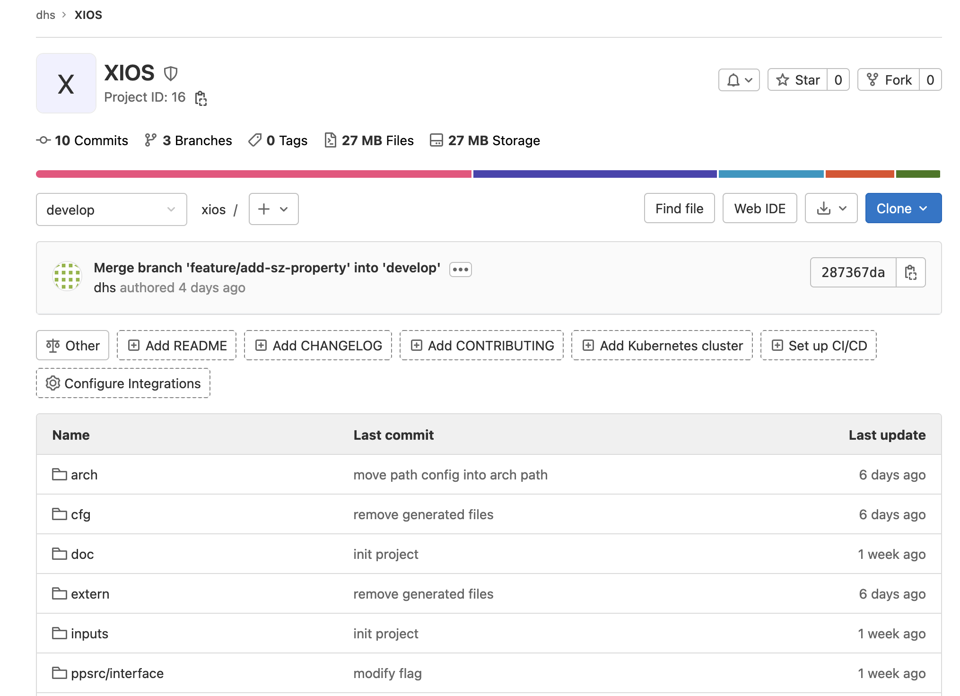
Implementation Progress
XIOS Repository
The default repository so huge, slow when navigate directory.
Create new git repository at HPCLab GitLab dhs/xios
Remove/Ignore compiled files or generated files (reduce sized and faster clone/backup)

Slide 18
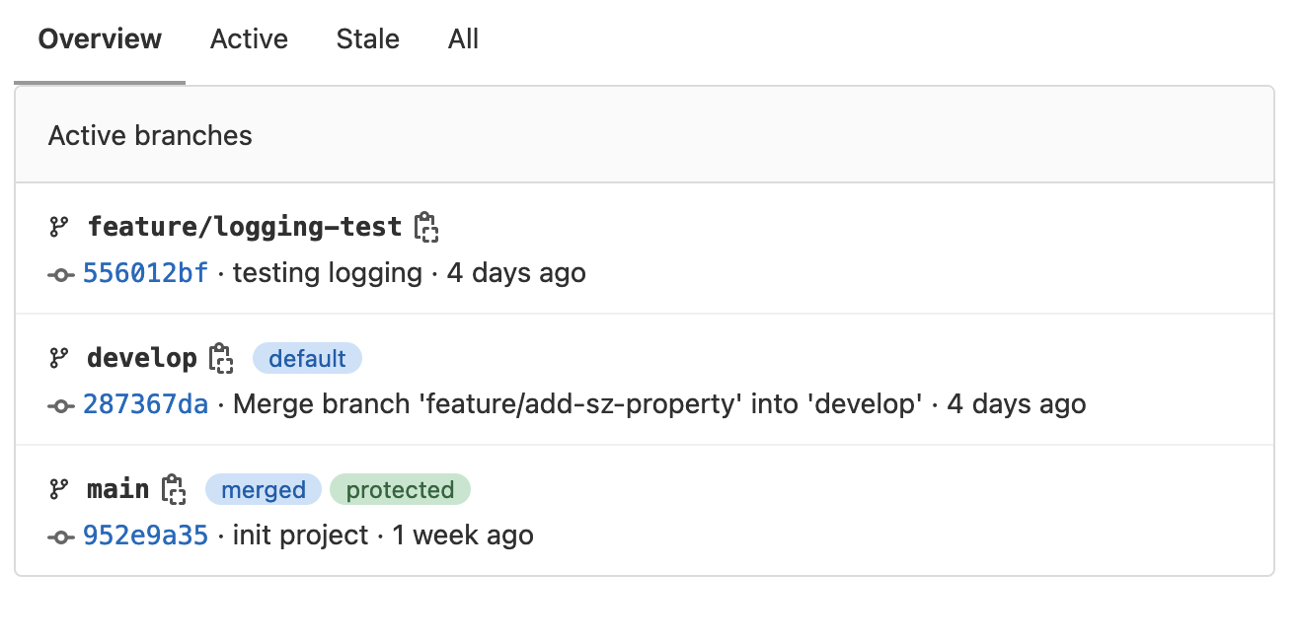
Implementation Progress
Branches
Development follow Git branching methodology
main branch: store main XIOS code (before modification)
develop branch: development version of XIOS (modified)
feature/*: feature specific development version
Branches can help to avoid bugs and easy to switch to a working version.

Slide 19
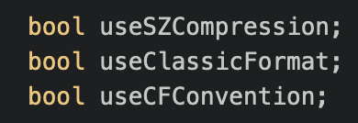
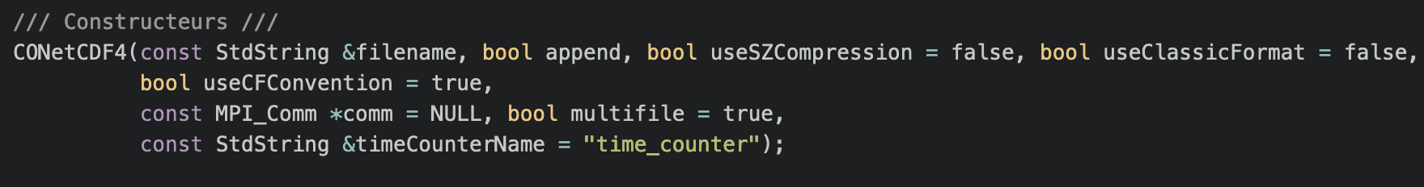
Implementation Progress
Modification
Add useSZCompression property in onetcdf4.cpp, onetcdf4.hpp, nc4_data_output.cpp, nc4_data_output.hpp
Modify the constructor

Slide 20
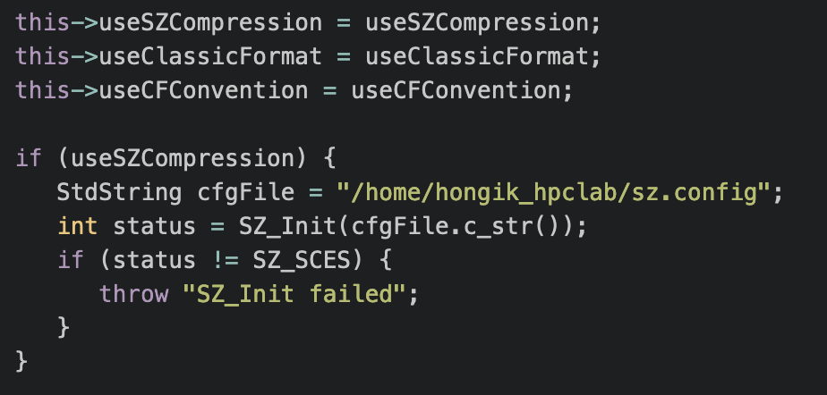
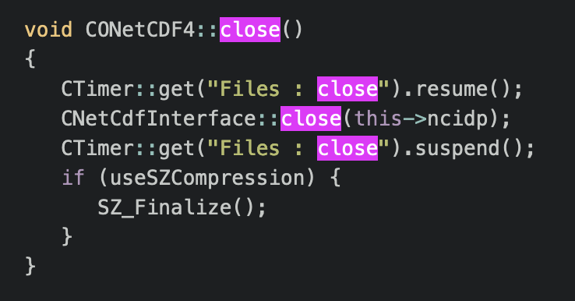
Implementation Progress
Modification
Call SZ_Init if useSZCompression is enabled on initialize() function
Add SZ_Finalize() when close the file

Slide 21
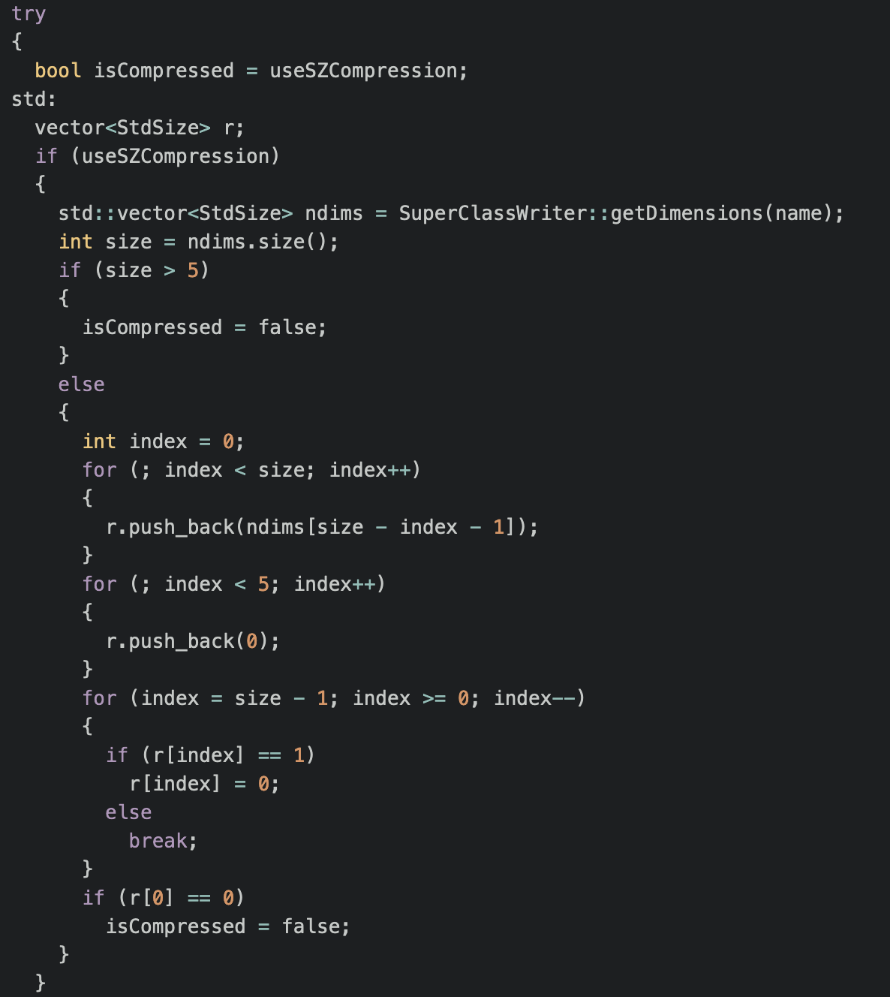
Implementation Progress
Modification
Calculate dimension and normalize
Set into 0 if for the remaining dimension
Check if compression is supported for given dimension

Slide 22
Implementation Progress
Modification
Calculate dimension and normalize
Set into 0 if for the remaining dimension
Check if compression is supported for given dimension

Slide 23
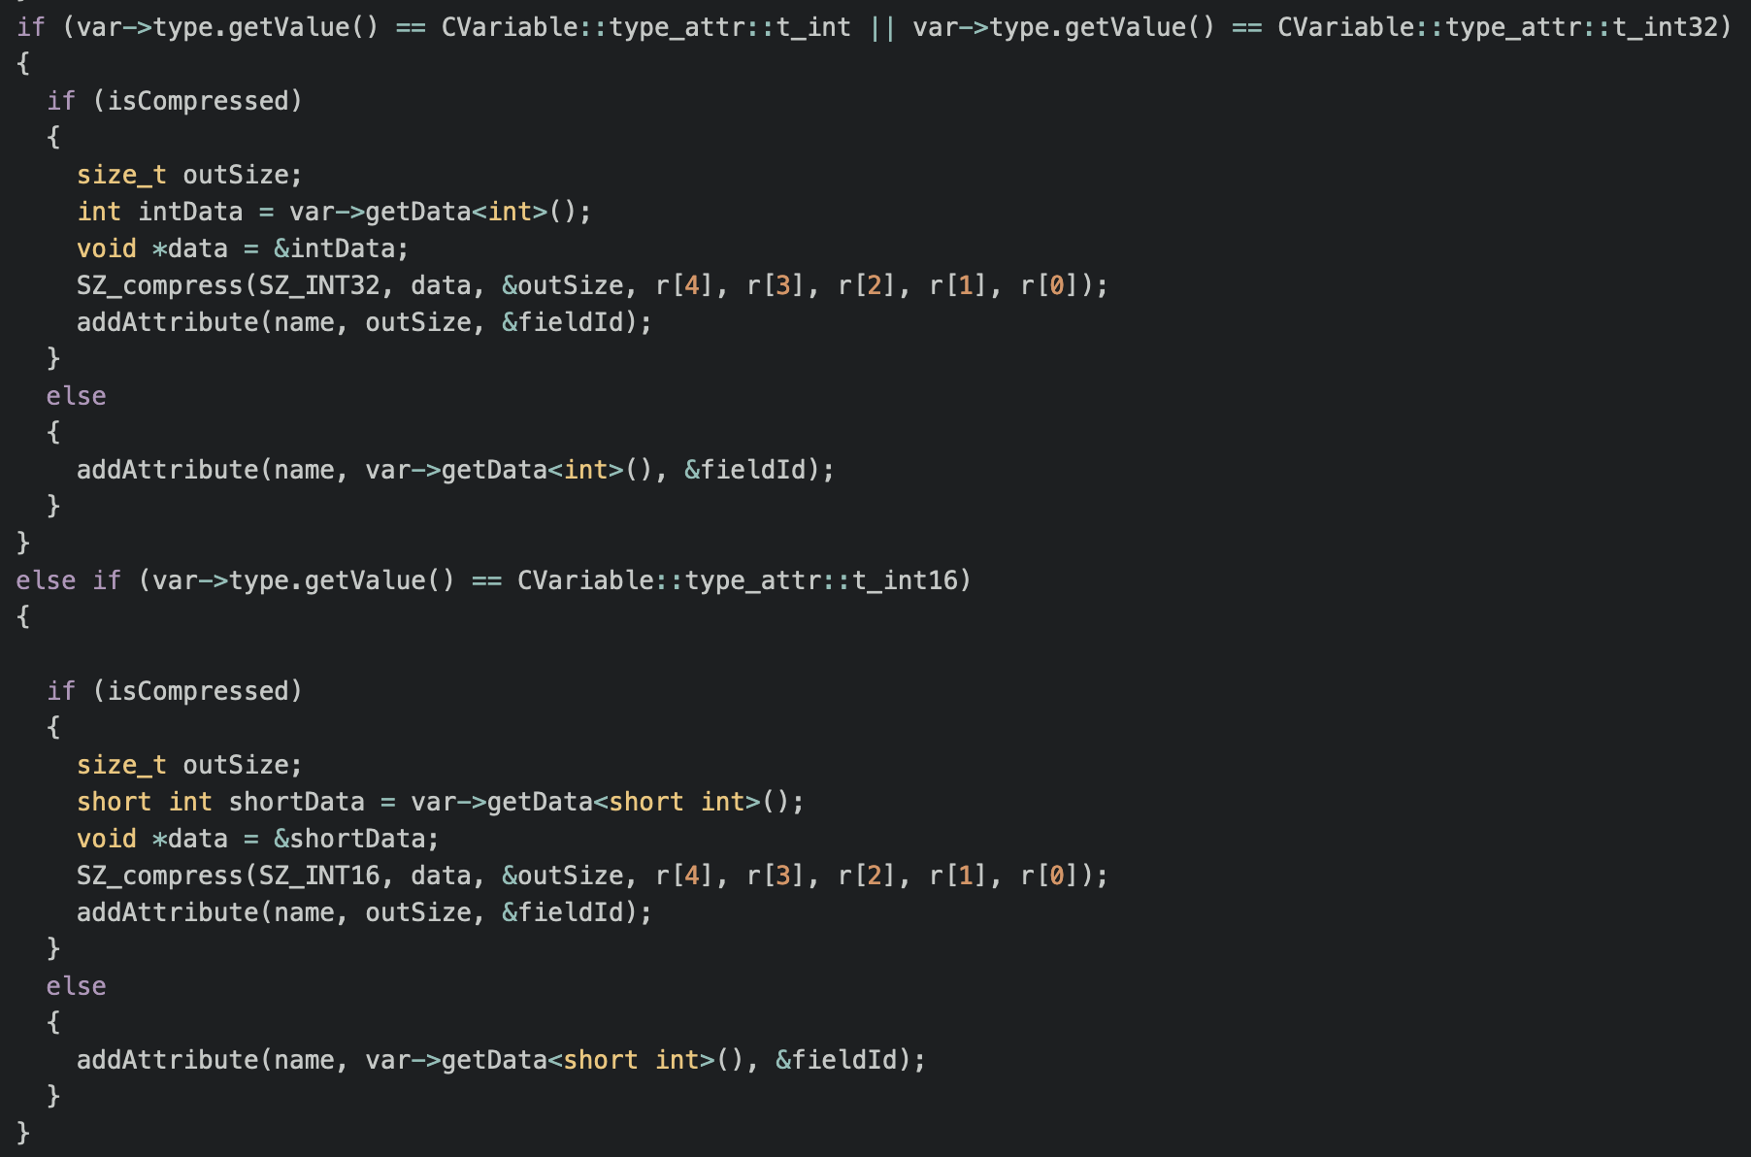
Implementation Progress
Modification

Slide 24
Conclusion
Simulation for bigger UE has been conducted
Resource utilization performance of simulation can be gathered via grafana
SZ library integration into XIOS has been implemented
applied netCDF compression using SZ needs to gather dimensions, datatype and recalculate new dimensions.
Basic flow of compression has been implemented. Verification and testing is required.

Slide 25
Your opinion/thought
Simulation evaluation of another metrics using same topology is required
Ensure the compression process is perform on the right input model (not the restart file)

Slide 26
Action items
Modify the topology of ransim and ns-o-ran using the same topology
Evaluate SZ compression model result
Implement logging to ensure the applied right compression
Because of the hydroserver issue, maybe require to setup Low GloSea6 on another server.

